Slide 1

INTERNSHIP
PRESENTATION
Domain : Data Science
JOYLINE RENCITA DSOUZA
4SO20CS073

Slide 2

Table of
CONTENTS
01
02
03
04
About The Company
Tasks Performed
About The Internship
Internship Content(Description and Features)
05
06
07
08
Project Implementation
Machine Learning Algorithms
Outcomes
Conclusion

Slide 3

About The Company and Services
CodersCave is a project-based learning organization located in Chennai, Tamil Nadu, India, dedicated to shaping a strong tech future for all developers.
The Belief is that “practical knowledge is key to success in the tech industry”, and the aim is to help individuals develop the personal and professional skills they need to excel in their careers.
Their programs are designed for students who are interested in starting a career in a technical field but lack basic knowledge.
They support students in acquiring new skills by providing opportunities for hands-on learning through live projects and real-world examples.
Offers internships in Web and App Development, Java, Python and Data Science

Slide 4
KEY OBJECTIVES
Enhance practical skills in machine learning through hands-on projects and real-world applications.
Gain exposure to industry-standard tools, methodologies, and best practices in machine learning.
Develop proficiency in solving complex problems using machine learning algorithms and techniques.
ork on real-world projects to apply theoretical knowledge and build a strong portfolio.

Slide 5
Task Performed
Week 1 : Foundation Walkthrough (Python)
Explored Python programming features and fundamentals. Also covered Python basics, including data types, variables, and loops.
Engaged in hands-on Python exercises for practical understanding.
Discussed module installation with PIP, focusing on libraries like NumPy, Matplotlib, Scikit-learn, Seaborn, and other essential packages.

Slide 6
Task Performed
Week 2 : Foundation Walkthrough (Machine Learning)
Discussed the basic concepts of Machine Learning.
Gained theoretical knowledge of Machine Learning categories, including Supervised Learning, Unsupervised Learning, Reinforcement Learning, and Semi-supervised Learning.
Introduced to various Statistical Concepts, crucial for understanding Machine Learning.

Slide 7
Task Performed
Week 3 : Capstone Project (Diabetes Prediction)
Utilized datasets from open sources, such as Kaggle, for project implementation.
Learnt different Machine Learning Algorithms like Logistic regression,Naive Bayes, K-Means Clustering, K-Nearest Neighbour Classification algorithm, Random Forest, and Support Vector Classifier.
Learnt Pre-processing techniques necessary for Machine Learning and their importance.

Slide 8
Task Performed
Week 4 : Final Project Implementation
Handled data by removing duplicates, outliers, and addressing null values.
Constructed predictive models employing various algorithms including Logistic regression, Naive Bayes, K-Nearest Neighbour Classification algorithm, Random Forest, Support Vector Classifier and Decision Tree Classifier .
Evaluated model effectiveness by analyzing Various Accuracies of Different ML Algorithm Models.

Slide 9

INTERNSHIP WORK

Slide 10
Project Description
Diabetes is a prevalent chronic disease impacting millions globally, affecting the pancreas and insulin production. Factors like body weight, inactivity, high blood pressure contribute to diabetes.
Diabetes leads to complications affecting the skin, nerves, eyes, and can result in kidney failure and retinopathy.
Early and accurate diabetes diagnosis is a significant challenge for medical professionals, leading to exploration of AI and ML solutions to enhance prediction capabilities.
More accurate diabetes analysis is in demand, pushing the search for better methods.

Slide 11
Project Features
The dataset encompasses a total of 768 records, each comprising 9 features. These features are of either integer or float data types.
Features are : Pregnancies, Glucose, BloodPressure, SkinThickness, Insulin, BMI, DiabetesPedigreeFunction, Age, Outcome.
The dataset is made to ignore the exceptional cases which will degrade the model’s efficiency. It is taken care of in the pre-processing of the dataset.

Slide 12

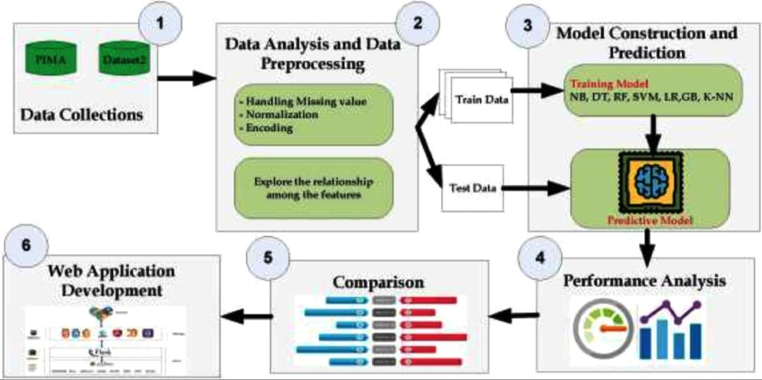
PROJECT IMPLEMENTATION
Aim : Detecting whether a patient is diabetic or not using machine learning

Slide 13
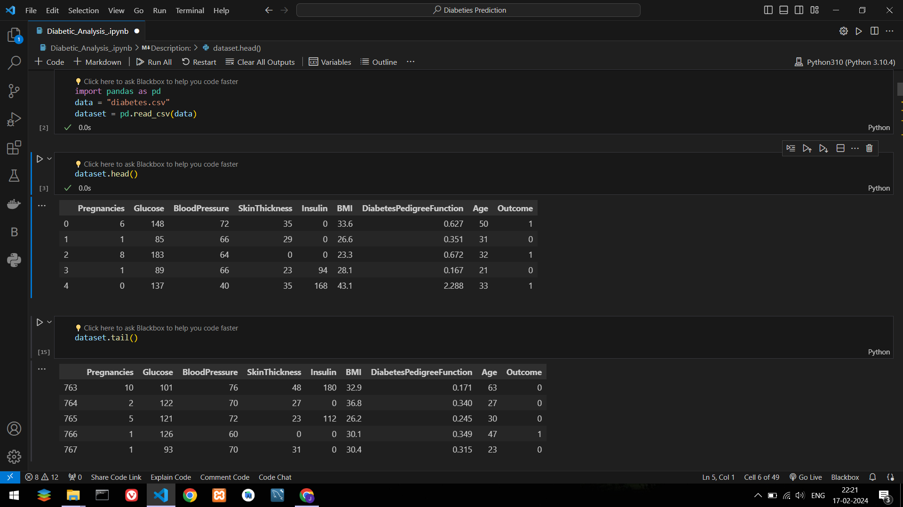
Dataset

Slide 14
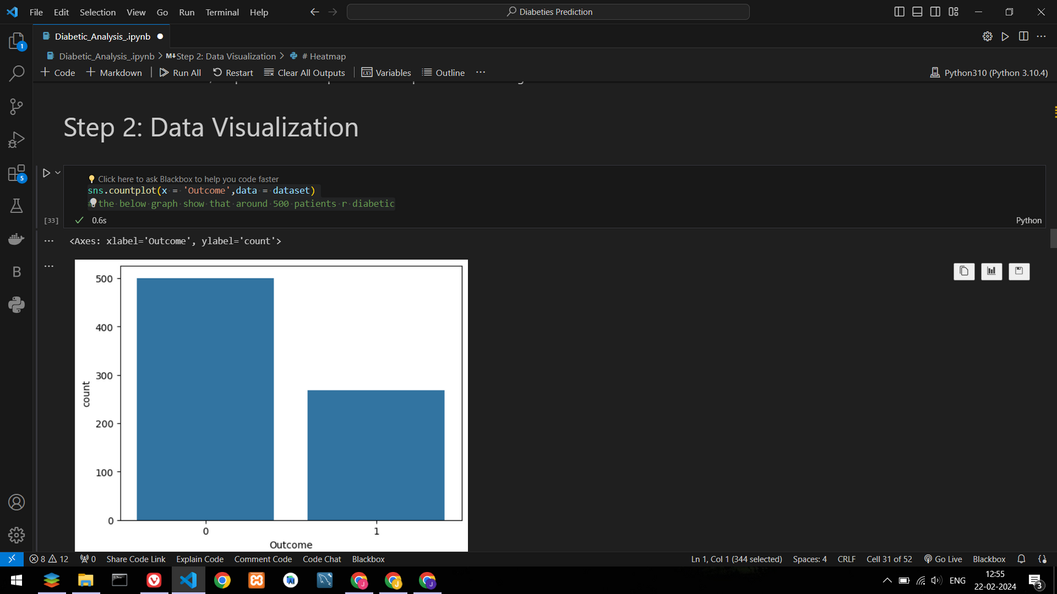
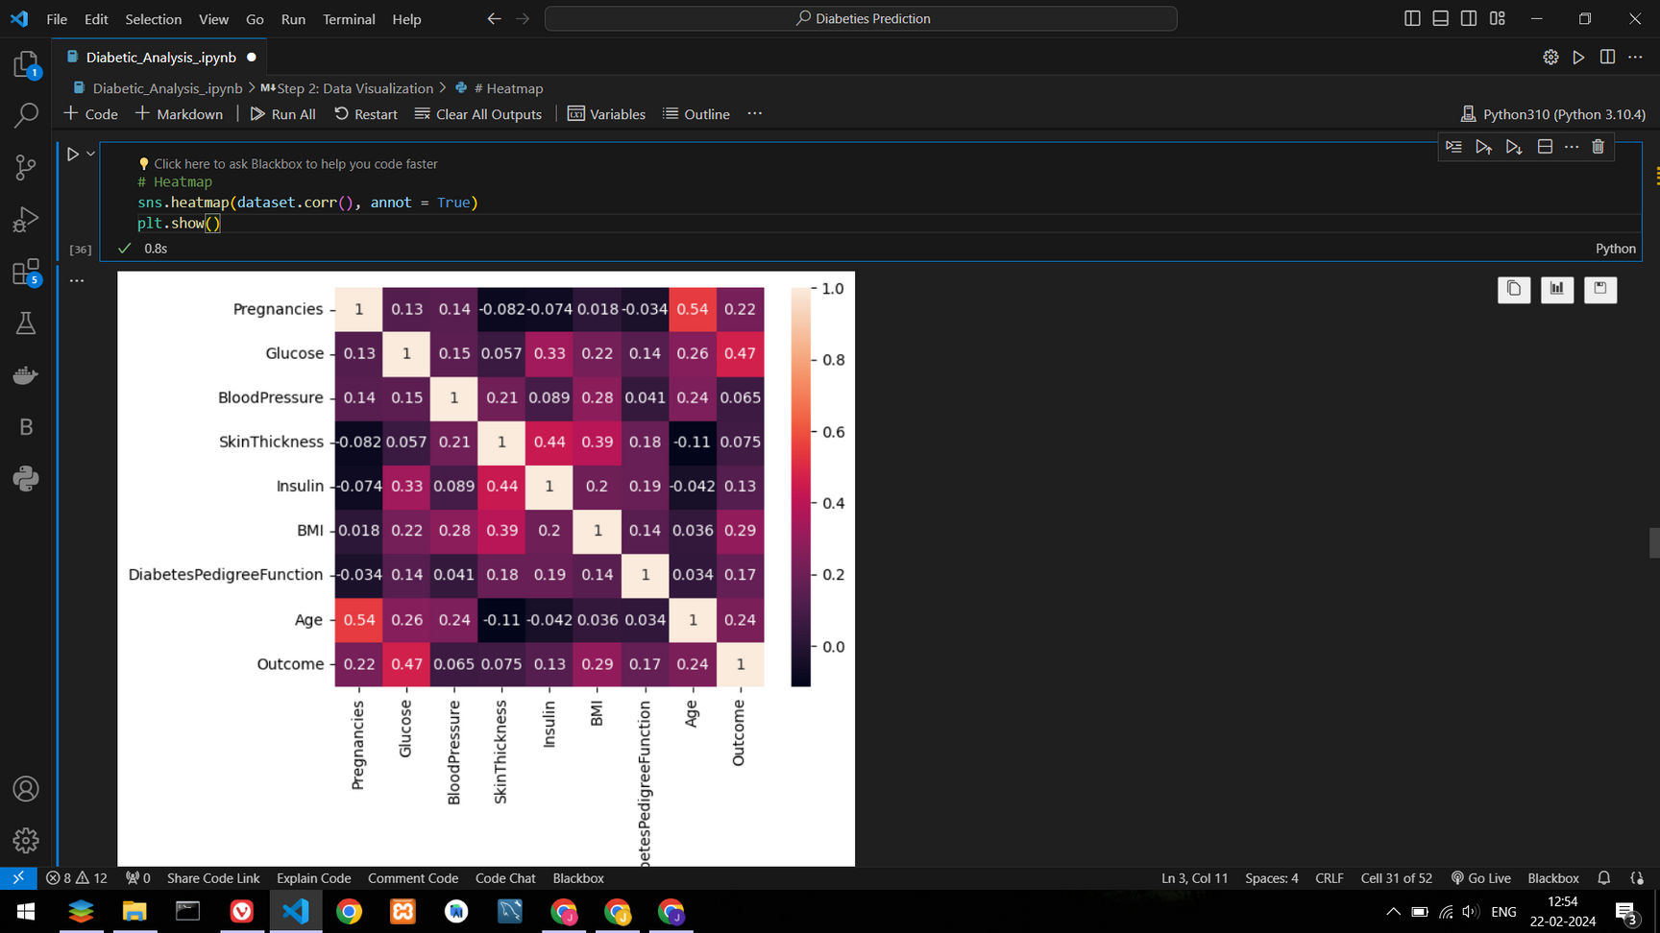
Data Preview
The count plot reveals the distribution of diabetic and non-diabetic patients, indicating around 500 individuals diagnosed with diabetes.
The heatmap displays feature correlations, offering insights into inter-feature relationships and dependencies.

Slide 15
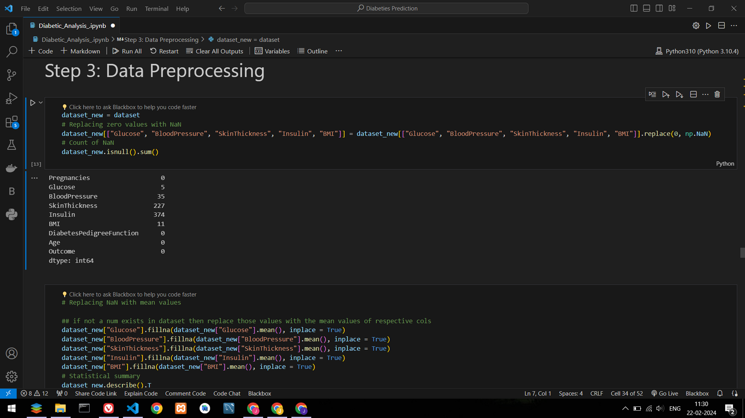
Pre-Processing
This code replaces zero values with NaN in specific columns and then counts and displays the number of missing values (NaN) in each column, highlighting instances like 5 missing values in "Glucose" and 35 in "BloodPressure." The counts signify the replaced zeros, aiding in identifying missing data during data preprocessing

Slide 16
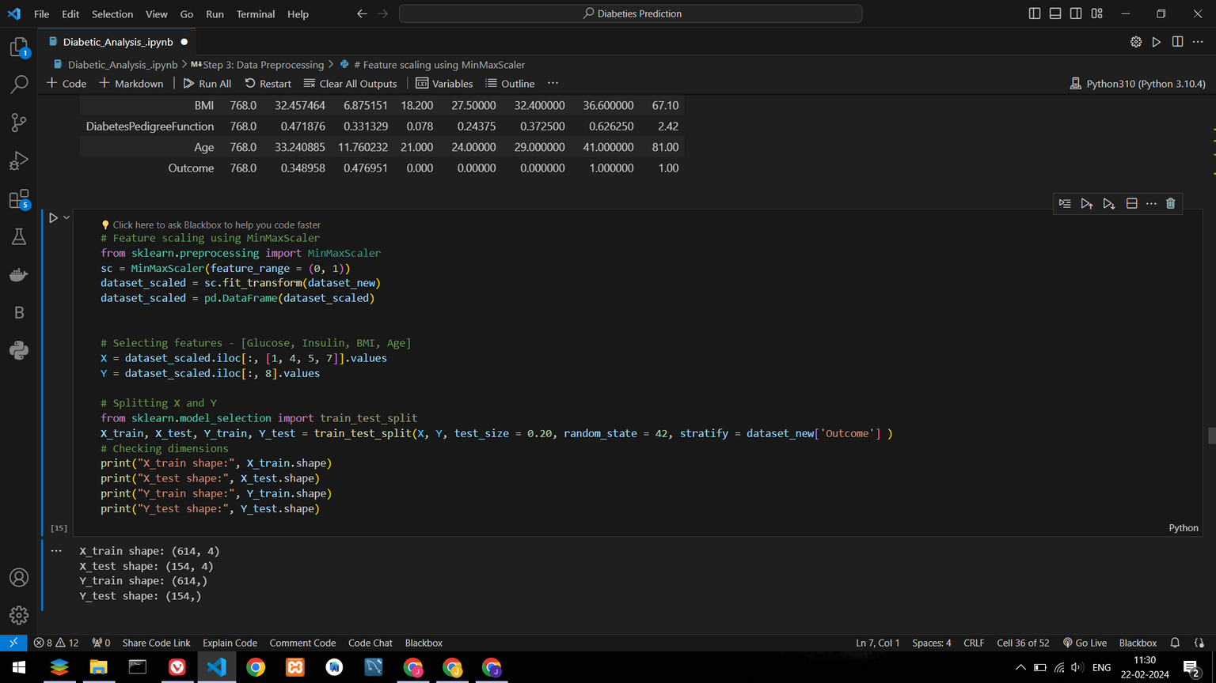
Pre-Processing
This code performs feature scaling using MinMaxScaler on selected features and splits the dataset into training and testing sets, ensuring balanced outcome distribution. The resulting dimensions show X_train, X_test, Y_train, and Y_test shapes.

Slide 17
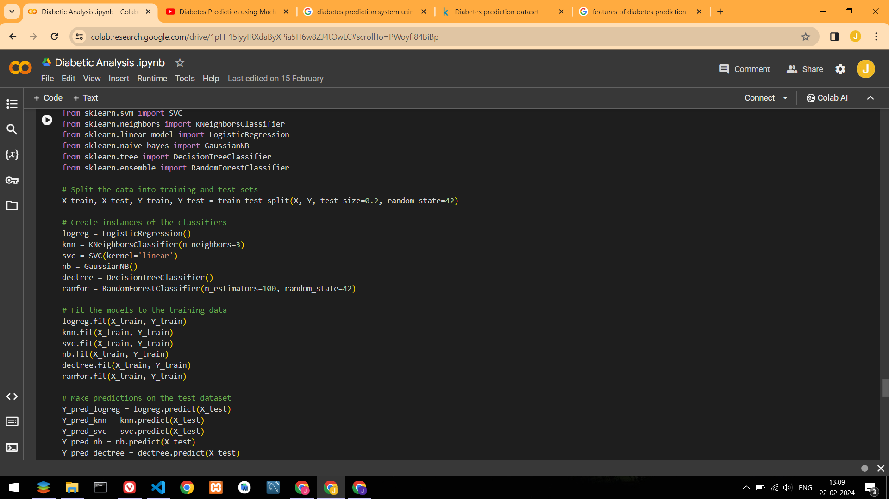
Data Modelling
Six different machine learning models, including Logistic Regression, K-Nearest Neighbors, Support Vector Classifier, Naive Bayes, Decision Tree, and Random Forest, have been trained and tested on the diabetes prediction dataset.

Slide 18
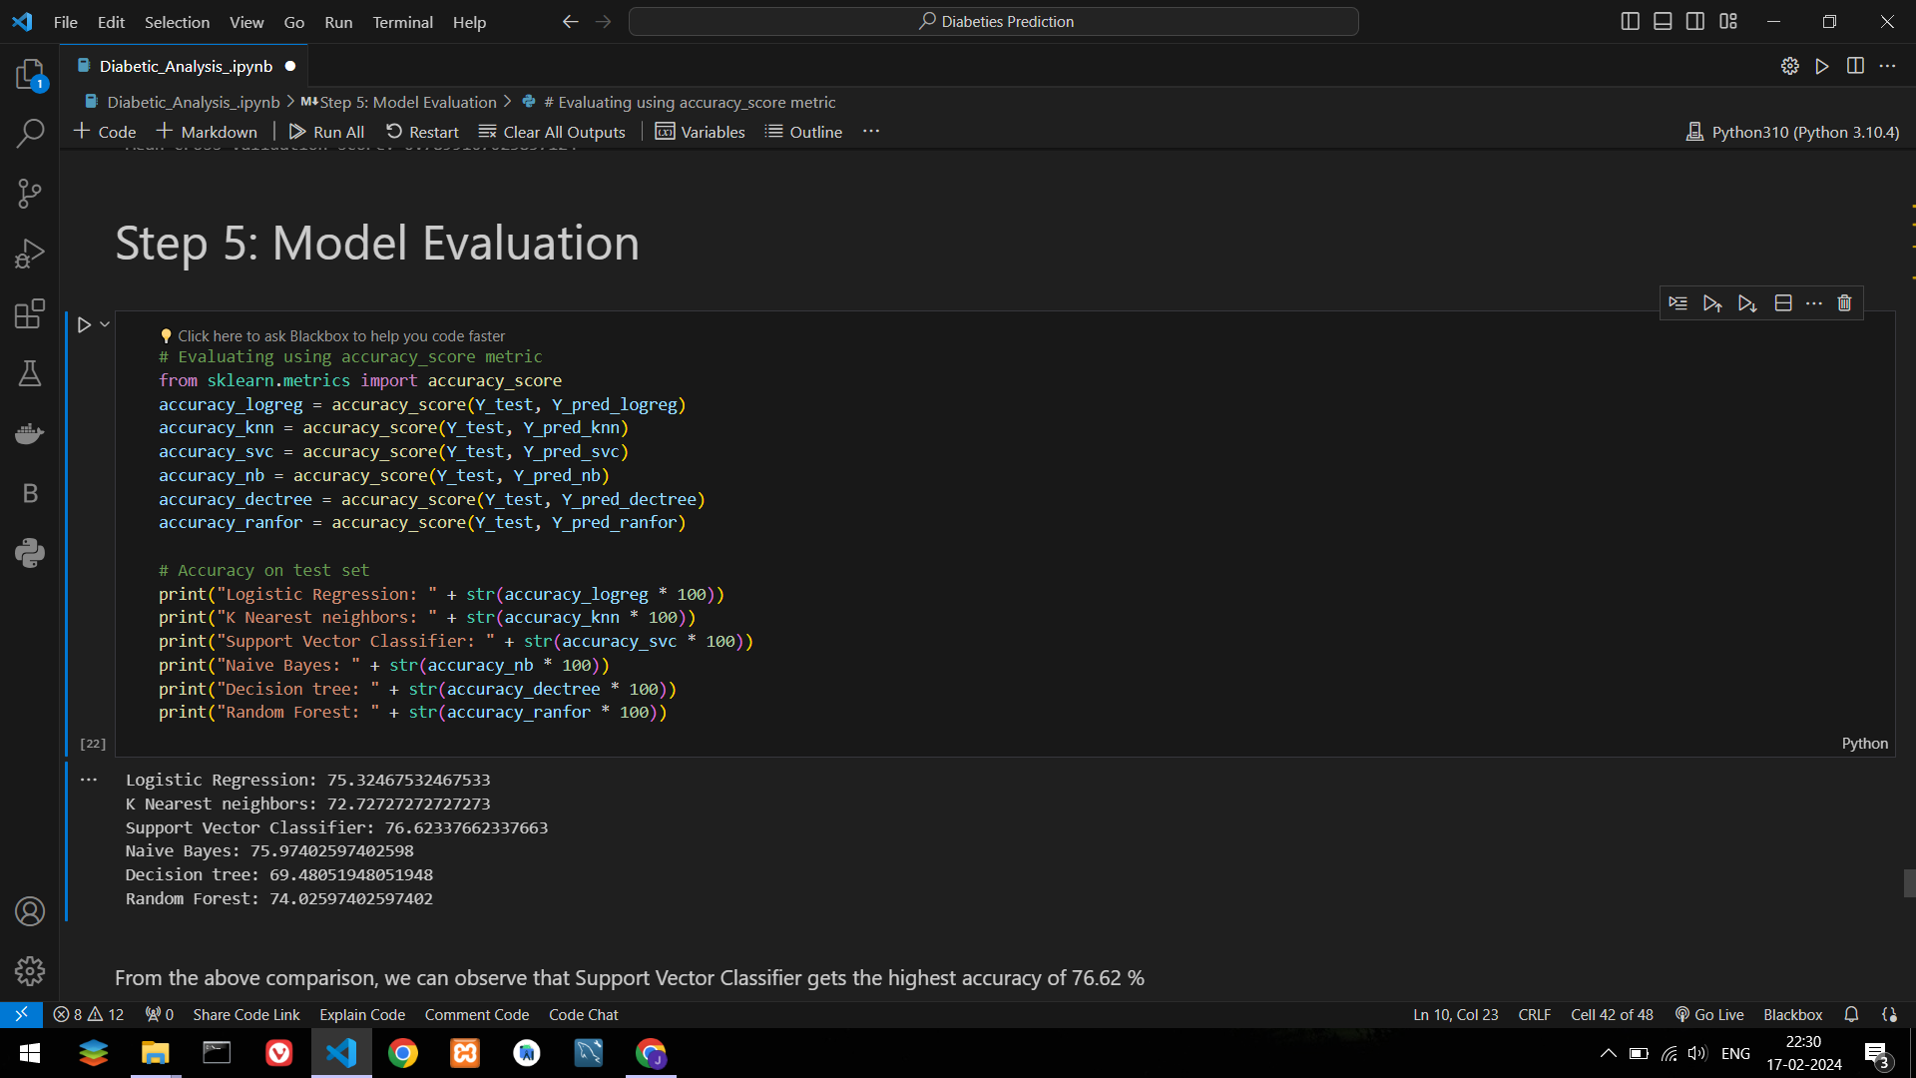
Model Evaluation
The model evaluation showcases the accuracy of multiple classifiers, such as Logistic Regression, KNN, SVC, Naive Bayes, Decision Tree, and Random Forest, in predicting diabetes outcomes.

Slide 19
OUTCOMES
Technical:
Non-Technical:
Python Programming
Machine Learning Statististics
Data Visualisation
Problem Solving
Personal Growth
Time Management
Critical Thinking

Slide 20
CONCLUSION
In this project, we applied machine learning techniques to construct predictive models for distinguishing diabetes cases, predicting whether an individual is diabetic or not, leveraging essential features.
Through extensive data pre-processing, feature selection, and model evaluation, we achieved promising results in predicting Diabetes.
Our best-performing model, Support Vector Classifer, achieved an accuracy of 76.62% on the test dataset, showcasing its effectiveness in classifying diabetic cases.
The findings from this project can potentially aid healthcare practitioners in achieving accurate and efficient diagnosis of diabetes.

Slide 21
REFERENCES
Statistical Analysis: https://www.simplilearn.com/what-is-statistical-analysis-article
Machine Learning: https://www.geeksforgeeks.org/machine-learning
Python Programming: https://www.w3schools.com/python/
Machine Learning Algorithms For Diabetes Prediction And Diagnosis:
https://www.sciencedirect.com/science/article/pii/S1877050921014629

Slide 22
THANK YOU

